Slide 1
GE MRI OPERATOR CONSOLES

Slide 2
Objectives:
To differentiate the GE MRI operator consoles
Understand the components of the Excite Operator Workspace
Understand the components of a GOC or Global Operator Console
To gain some basic troubleshooting skills and understand most common problems

Slide 3
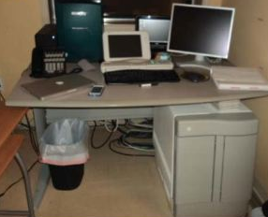
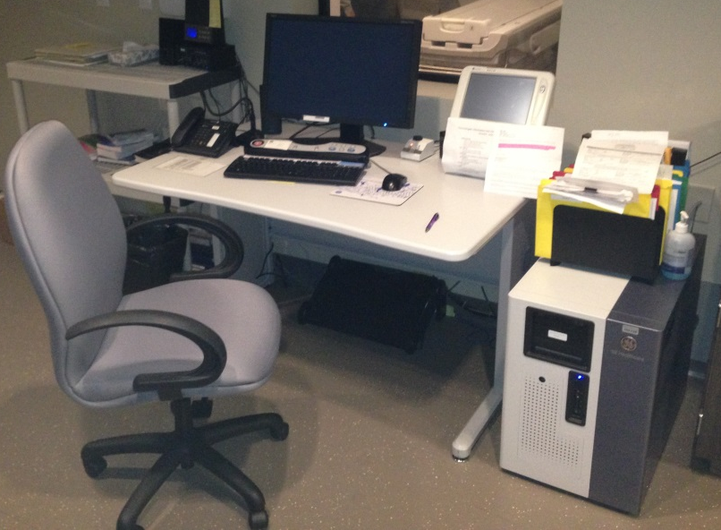
GE MRI OPERATOR CONSOLES MAIN TYPES
PRE-EXCITE CONSOLE
EXCITE OR NEWER CONSOLE

Slide 4
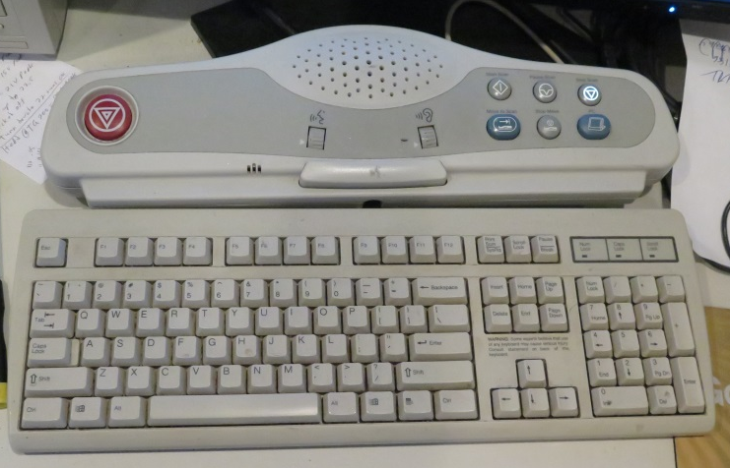
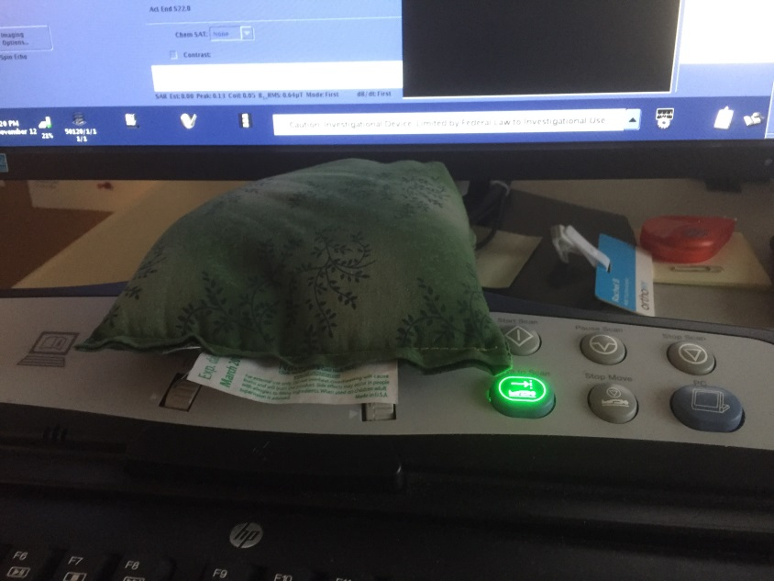
SCIM (Scan Control Interface Module) and Keyboard
SCIM includes table movement and scan control buttons, and also has speaker controls for intercom.
It has a monitor button to go back and forth between the console monitor and the PC monitor.
E-Stop connected to it with push button.
If SCIM or keyboard are disconnected or defective SCIM E-Stop will not reset.

Slide 5
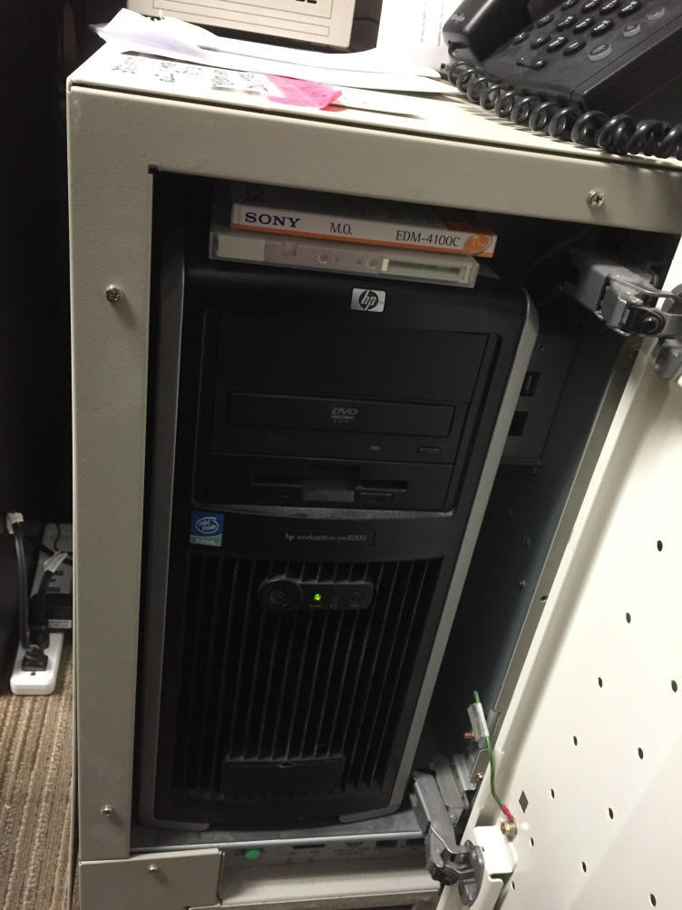
EXCITE OR NEWER
GOC or Global Operator Console:
Smaller cabinet with either grey/white door (11x-16x) or blue and white covers (23x and above)
HP computer with only one monitor
HP XW8000, XW8200, XW8400, XW9300, Z400, Z420 or Z600?
Red Hat linux (11x-12x) or OpenSuse (14x and above)
WIM moves from under the table to the right side of the GOC, same functionality but much more reliable
Network hub on the right side of the cabine
No power module under the table
11x-16x SCSI tower is on the table with either just MOD, MOD and DVD drive or only DVD drive depending on version
23x and above no longer have the SCSI tower and they use the DVD drive in the HP computer.
11x-14x mouse and keyboard still connects to SCMI but 15x and above it is connected directly to the USB in the HP computer

Slide 6
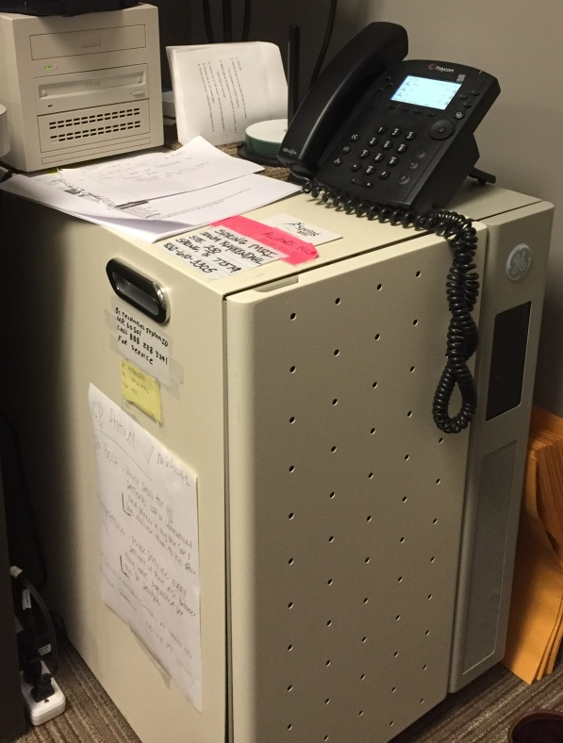
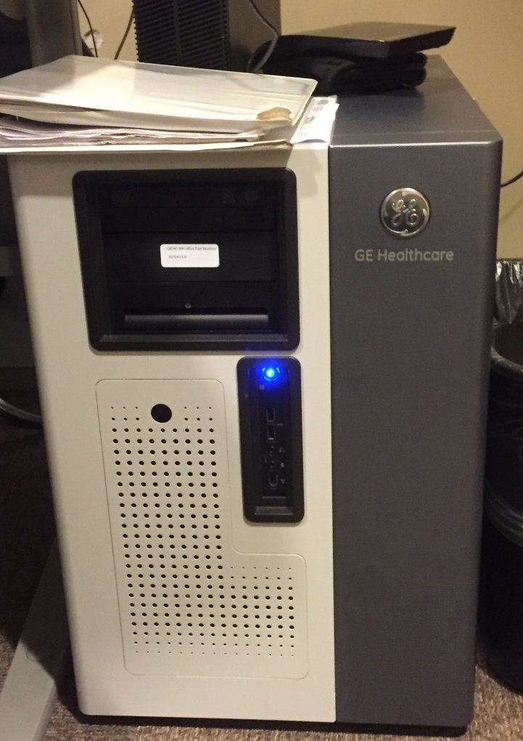
GOC

Slide 7
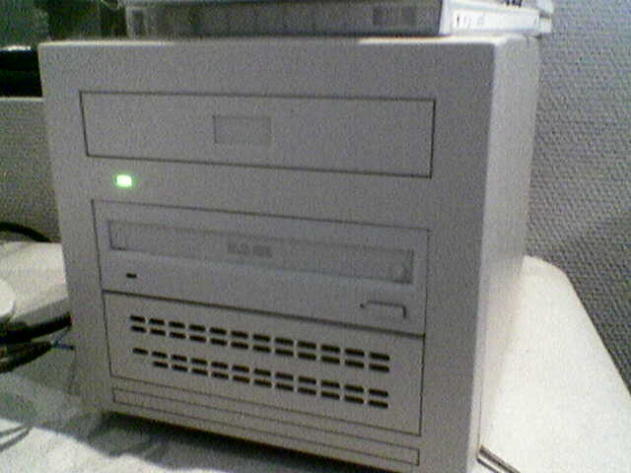
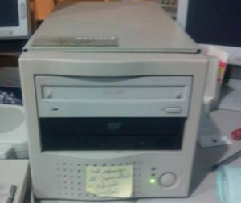
SCSI Tower
Two types of SCSI towers, one has only one SCSI connector and one has a connector and a terminator
Different MOD drives and DVD drives have different jumper settings.
Two different types of SCSI to IDE boards for the DVD drives with different jumper settings
Tower has a power supply
Refer to Service Methods for your system>Replacement>System>GOC

